Slide 1
GitHub Pages
A non-exhaustive introduction by
@KirbyPaint

Slide 2
Introduction to Programming
In the beginning, the universe was created, blah blah
Eventually, the abacus convinced humans to teach rocks to think, so it may finally retire
This ultimately led to the mistake that is JavaScript and now we have websites and shit

Slide 3
Actual Introduction
GitHub Pages is free site hosting (within limits)
Comes with a domain (username.github.io/repository)
  Username: your GitHub Username (KirbyPaint)
  Repository: where the code lives
GitHub Pages is one way to statically host a site
  Static site: pre-loaded information (personal blog, wiki)
  Dynamic site: user-submitted info (SocMed, YouTube)

Slide 4
What You Need
GitHub account (free!)
Text Editor
  Anything that edits text *can* be a code editor... but should it…? no
  Recommended: anything with syntax highlighting
    VS Code, Notepad++, there are others probably
  Not Recommended: Microsoft Word or any rich text editor, Vim*
    *Vim is actually very good if you already know what you’re doing.
    If you get stuck in Vim, just
      esc esc :q!
      see that makes total sense, right?????
    A terminal text editor will be much faster than keyboard & mouse, if you take the time to learn it <3 we do not have that time today

Slide 5
First steps
Make a new repository on GitHub
  Needs a unique (to you) repo name, description of the project
  MUST BE PUBLIC for a GitHub Pages site
  Optional
    README.md file, will only show on the repository home page, recommended for easier initial setup
    A .gitignore can be added later
    Licenses are more often used for code that will be re-used, not a static site

Slide 6
Using VS Code for Web
Press “.” in browser when viewing your newly-created repo
You can edit existing repository code in the browser
I do not know how to make it save new files idk wasn’t working
Useful when there is already code there

Slide 7
Cloning Your New Repo
What are all those science words???
“Cloning” a “repo” aka:
  Cloning: making a copy that knows where the original is
  Repo: short for “repository”

Slide 8
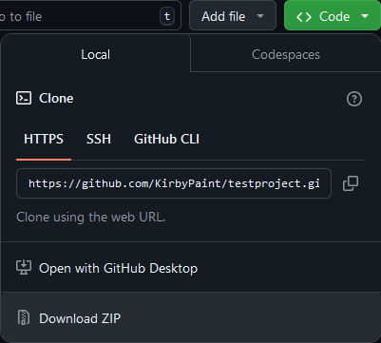
Cloning Repo pt. 2
On repo home page look for big green button
Click it and find “Download ZIP”
Extract that
Go into it all the way until you see your README

Slide 9
Baby’s First HTML Document
Create a new file named index.html somehow:
  Windows
    GUI: open notepad, save file name as “index.html” AND save type as “All Files”
    Command Prompt: pray that it’s opened to C:\Users\your_user>
      cd Downloads and Enter and then cd repo_name and Enter and then:
      type nul > index.html
      Enter

Slide 10
Baby’s First HTML Document
Create a new file named index.html somehow:
  Non-Windows
    Mac GUI: open TextEdit, save file as index, file format .html
    Mac Terminal: ctrl+click the repo folder, Services > “New Terminal at Folder”
      touch index.html and then hit Enter
    Linux: wyd you probably already know all this, nerd, go install Arch
      cd /path/to/file && touch index.html

Slide 11
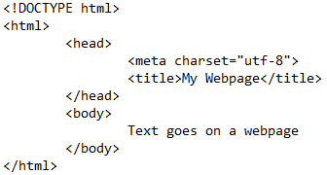
Coding!
Barebones HTML needs the following tags:
<!DOCTYPE html>
<html>
<head>
<meta charset=”utf-8”>
<title>
<body>

Slide 12
Committing Your Code
To commit code is essentially to create a save state of code
There’s a lot more to it than that but learning git is like ten more powerpoints ngl
We will not be installing the git cli here, we will be using the web editor instead
Since Git is meant to be interfaced via command line, this presentation will lack a lot of the power of the cli
cli means command line interface, you say it c-l-i not “clih”

Slide 13
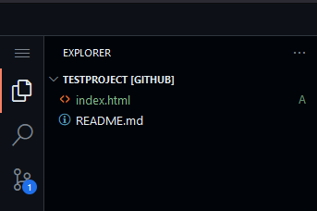
Committing Your Code
Go back to the web editor for VS Code with your project
Drag and drop index.html into your project root (top level)
See the circle lines with a 1? That means you have Uncommitted Changes

Slide 14
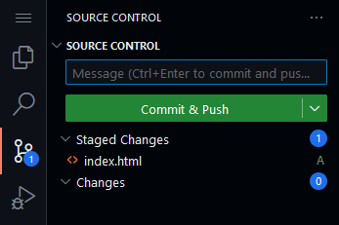
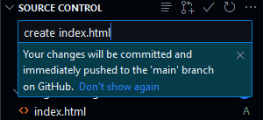
Committing Your Code
Click the + next to your file(s) you want to commit
Anything under Staged Changes will be in one commit
Enter a short message describing the commit
Commits should be present-tense “add file” vs “added file”
That’s not required by law or anything, just convention

Slide 15
Sidebar: Branches
Git is version control, which means that multiple versions of code (branches) can exist.
By convention, the master branch has been renamed to main, to distance from master/slave terminology
Also it is a 33% reduction in total typed characters, saving precious keystrokes :D
Why this is important:

Slide 16
Sidebar: Branches
GitHub Pages works off of the gh-pages branch
Anything named gh-pages with a root index.html file is known by GitHub to deploy in a particular way
Do not worry about changing branches right now, that happens soon

Slide 17
Committing Your Code
Once your changes have been staged and your commit message has been written, click “Commit & Push”
“Pushing” the code commit to the main branch is like saying “This is the version of my code I want others to see”
In a production environment, if you are pushing to main, you better be the senior developer or you work at a terrible place
Commits are good ways to test code functionality – if something goes wrong, revert the commit (out of scope for this lesson)

Slide 18
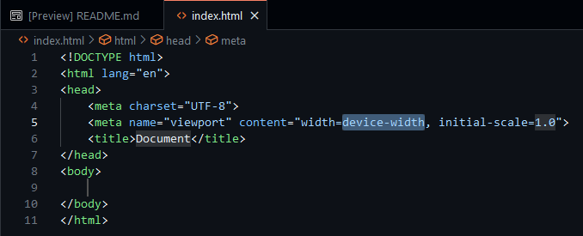
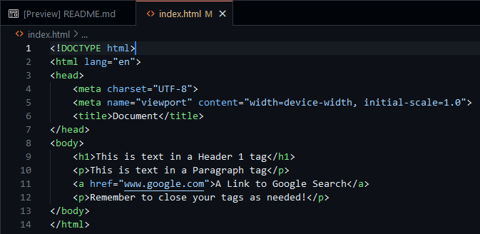
Using the Editor
VS Code has nice shortcuts
On index.html, type “!” then press Tab
Watch as it autofills all the barebones html with some extras
Highlighted areas can be typed and tabbed through
Make a few changes, maybe throw some text in the body, then stage the file, commit changes, and push to main

Slide 19
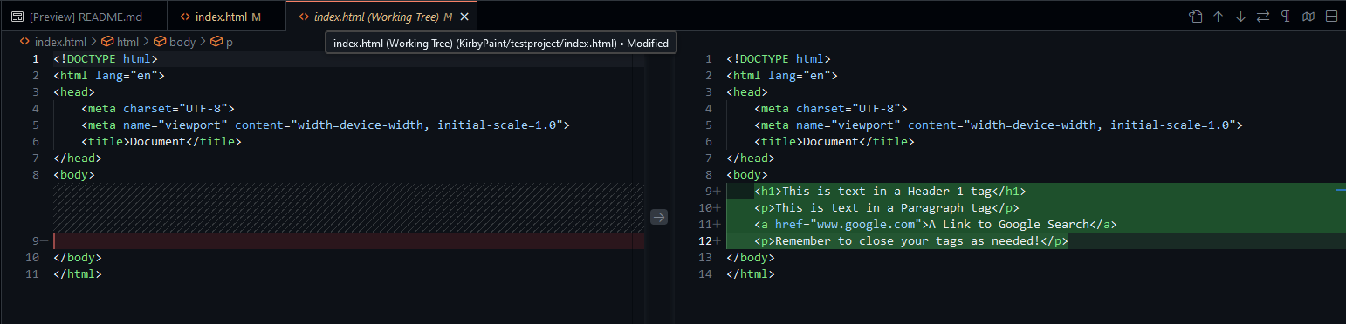
The Diff
The diff page will visually show changes you’ve made, handy when trying to come up with a commit message if you forgot what you did already (this is why small, frequent commits rule)

Slide 20
Viewing Your Page
VS Code when fully installed has ways to live preview your pages as you develop your site
If you edit outside of the web, you can just open your local index.html in your browser and refresh after you’ve saved your page
Out of scope for this lesson, but immensely powerful in a real coding environment

Slide 21
Merge Changes
Merging the branch is like putting two different code pages together. git merge will compare differences between branches and allow the developer to choose which code stays and goes
Generally, merging is not desirable, as it can squash commits, and rebasing is often preferred
This does not matter for this presentation, as it is too complex to explain the differences succinctly and in a way that matters
For now, we are treating gh-pages as a copy of main

Slide 22
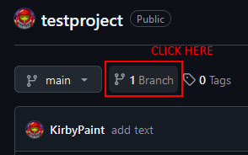
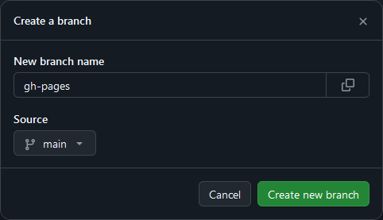

Merge Changes

Slide 23
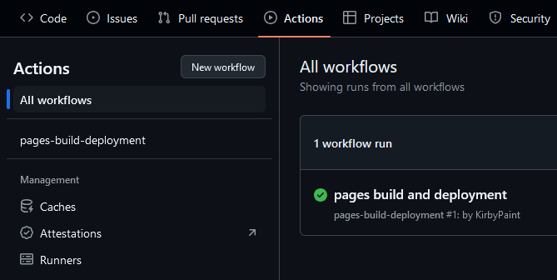
GitHub Actions
GitHub has automated CI/CD aka it will handle the site deployment
Go to the Actions tab on the repo to see the workflow
If everything is correct, the workflow will run and deploy your site

Slide 24
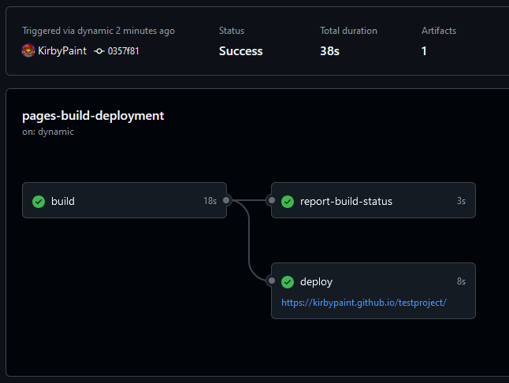
GitHub Actions

Slide 25
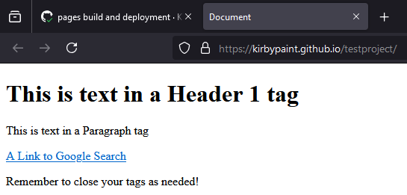
View Your Muhfukin Website
The Action should contain the deployment URL
If not, the page will be hosted at
  https://github_username.github.io/repository/

Slide 26


Slide 27
This work is licensed under a Creative Commons Attribution-ShareAlike 3.0 Unported License.
It makes use of the works of Mateus Machado Luna.

